Slide 1

Practical Submission Data Science Application & Tools
Presented By: Amit Sharma
[BSC Data Science]
Presented To: Mrs. Manpreet Bhatia
[Assistant Professor],
AAFT (SODS)
AAFT | SODS | 2024

Slide 2
Outline
1
Pandas
2
Numpy
3
Matplotlib
4
Plotly

Slide 3
1. Pandas

Slide 4
Parameter Vs Argument
Parameter
Argument
A parameter is a variable that is used in the declaration of a function or method.
It acts as a placeholder for the data that will be passed or supplied to the function when it is called.
Parameters are like variables within the function definition that represent the inputs to the function.
def greet(name): # 'name' is a parameter
print("Hello,", name)
An argument is the actual value that is passed to a function when it is called.
It is the data that is supplied to the function to be processed.
Arguments are provided within the parentheses when calling the function.
Arguments are the actual values that are passed to the function parameters.
greet("Alice") # 'Alice' is an argument

Slide 5
Pandas
Pandas is a Python library for data manipulation and analysis, offering powerful data structures like Series and DataFrame along with tools for cleaning, preparation, analysis, and integration with other data analysis libraries.
Importance of Pandas
Efficient Data Handling: Pandas provides efficient data structures like Series and DataFrame for handling structured data, making it easier to work with large datasets.
Data Cleaning and Preparation: Offers functions and methods for cleaning, transforming, and preparing data, including handling missing values and reshaping datasets.
Data Analysis: Facilitates exploratory data analysis by providing methods for grouping, aggregating, sorting, and filtering data, enabling insights into data patterns and trends.
Time Series Analysis: Supports time series data analysis with specialized functionalities for date/time indexing, resampling, and time zone handling.

Slide 6
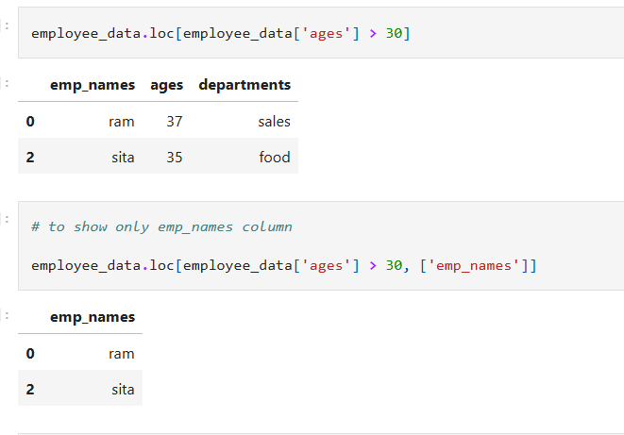
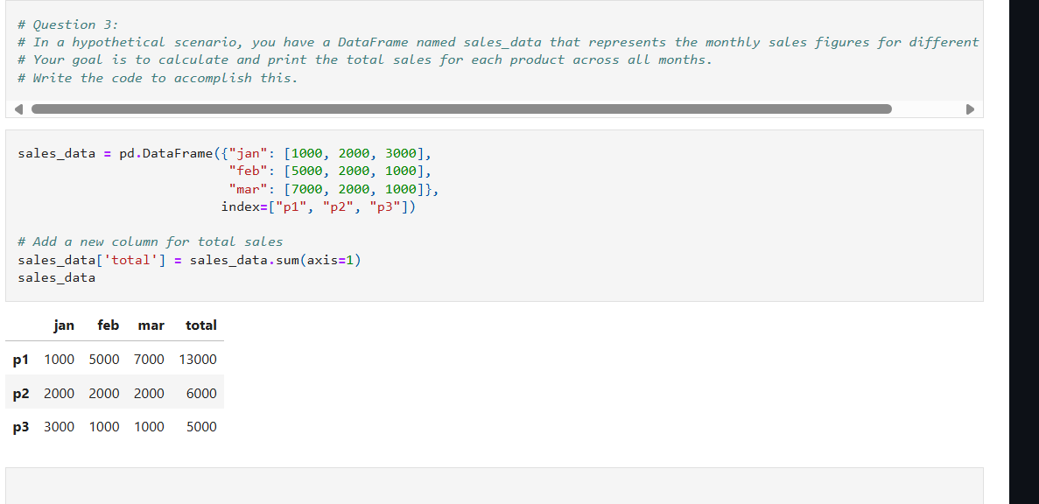

Slide 7
Pandas Data Structures
Series: One-dimensional labeled array.
DataFrame: Two-dimensional labeled data structure with columns of potentially different types.
Panel: Three-dimensional data structure, container for DataFrame objects.

Slide 8
2. Numpy

Slide 9
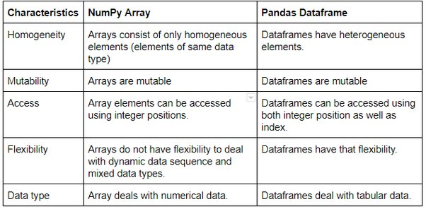
Numpy
NumPy is a Python library for numerical computing that facilitates efficient operations on arrays and matrices.

Slide 10
Advantages
Efficiency: NumPy arrays are highly memory efficient and provide fast numerical computations due to their implementation in C.
Functionality: NumPy offers a wide range of mathematical functions and operations optimized for arrays, making it ideal for scientific computing and data analysis tasks.
Broadcasting: NumPy's broadcasting feature allows for efficient element-wise operations on arrays with different shapes, reducing the need for explicit looping.
Disadvantages
Learning Curve: NumPy can have a steep learning curve for beginners due to its array-oriented programming paradigm and specialized functions.
Homogeneity: NumPy arrays are homogeneous, meaning they can only contain elements of the same data type, which may be limiting for certain applications.
Overhead: NumPy arrays have some overhead associated with them, especially for small datasets, compared to Python lists, which can impact performance in certain cases.

Slide 11
3. Matplotlib

Slide 12
Matplotlib
Matplotlib is a low level graph plotting library in python that serves as a visualization utility.
Matplotlib was created by John D. Hunter.
Matplotlib is open source and we can use it freely.
Matplotlib is mostly written in python, a few segments are written in C, Objective-C and Javascript for Platform compatibility.
Installation
C:\Users\Your Name>pip install matplotlib
If this command fails, then use a python distribution that already has Matplotlib installed, like Anaconda, Spyder etc.
Import Matplotlib
Once Matplotlib is installed, import it in your applications by adding the import module statement:
import matplotlib
Now Matplotlib is imported and ready to use:
Checking Matplotlib Version
The version string is stored under __version__ attribute.

Slide 13
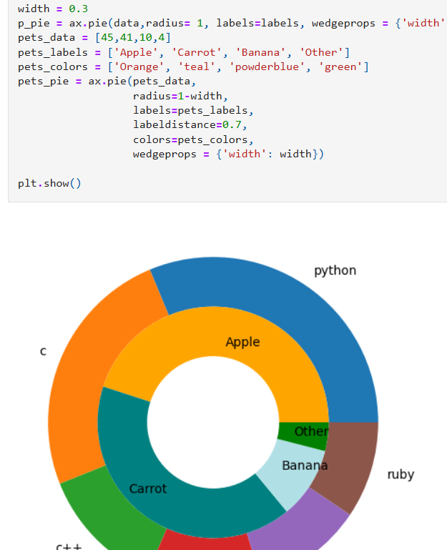
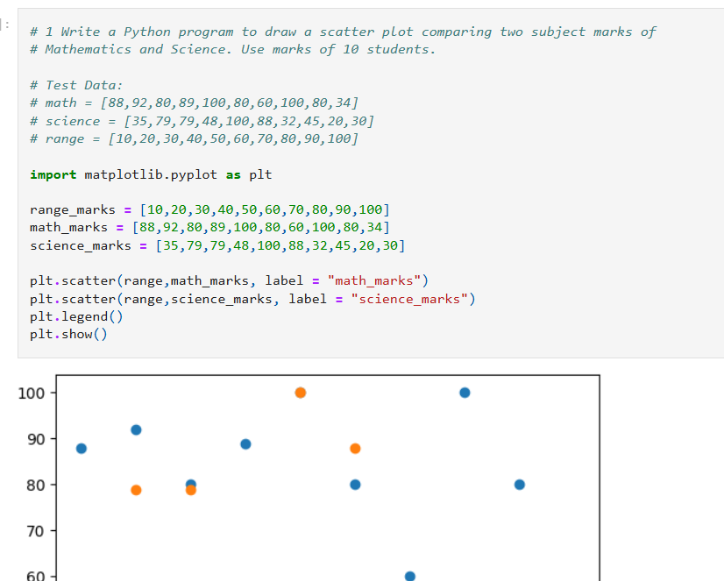

Slide 14
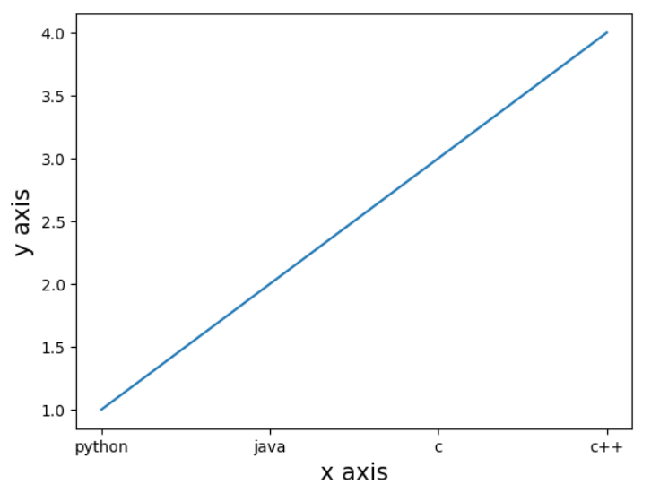
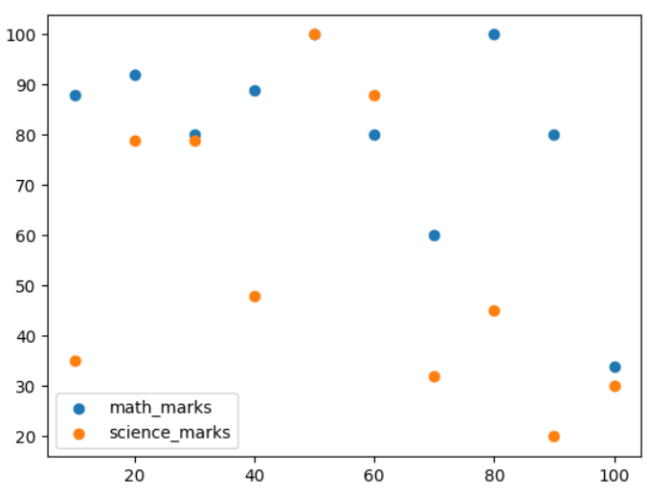
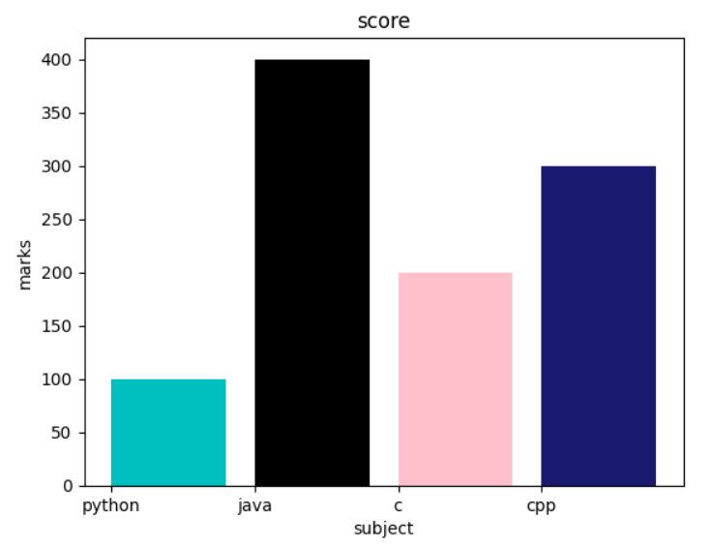
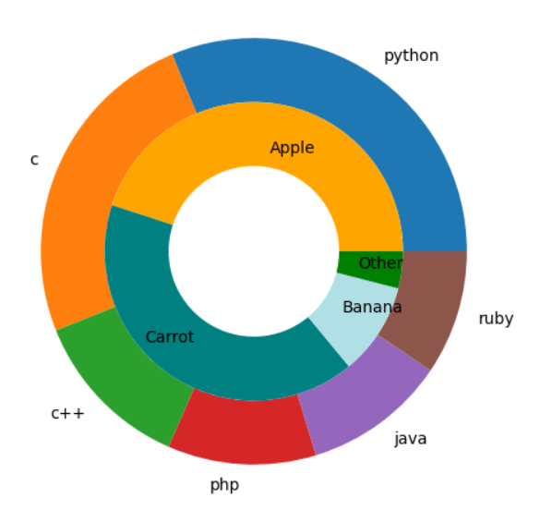
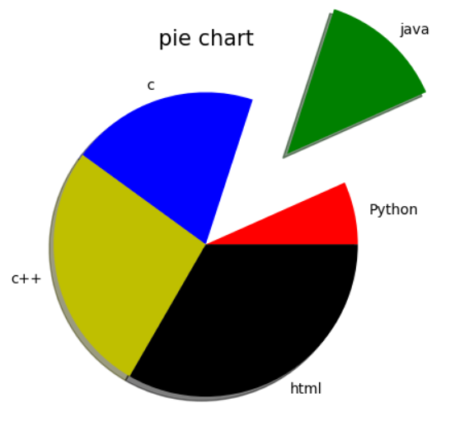
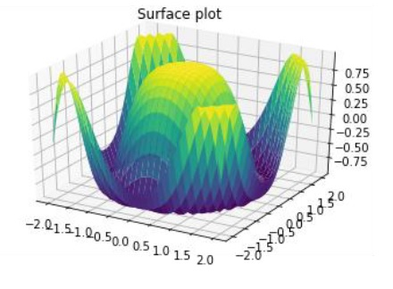
Matplotlib graphs
1. Bar Plot
2. Scatter Plot
3. Pie Chart
4. Line Plot
5. Donut Chart
5. 3D Plot

Slide 15
INTERACTIVE PLOTTING USING PLOTLY

Slide 16
PROJECTS

Slide 17
Plotly
Plotly is a Python library for creating interactive, publication-quality graphs and visualizations.
1. Interactive Graphs
2. High-Quality Visuals
Zooming, panning, hovering, and click events.
F Export high-resolution, publication-ready graphs.
3. Cross-Language Support
4. Dashboards
Available for Python, R, MATLAB, and JavaScript.
Dashboards: Create interactive web dashboards using Plotly Dash.

Slide 18
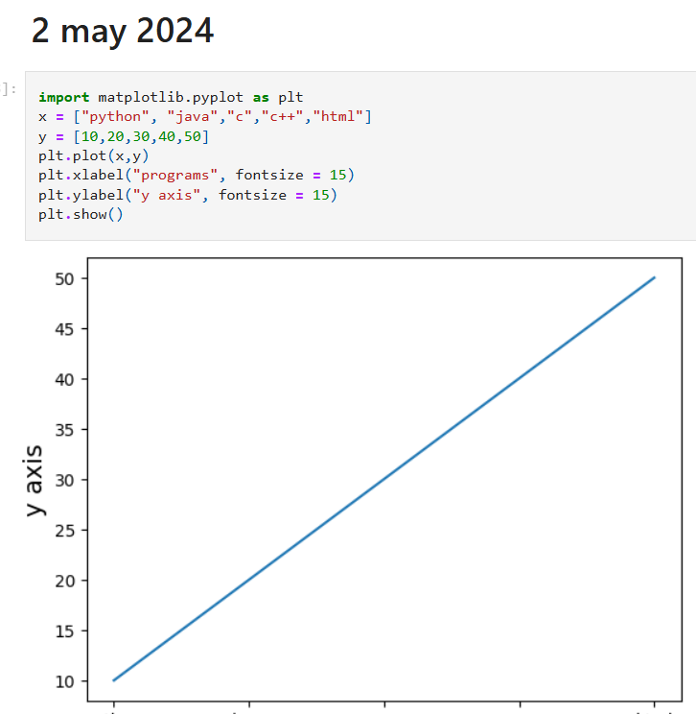
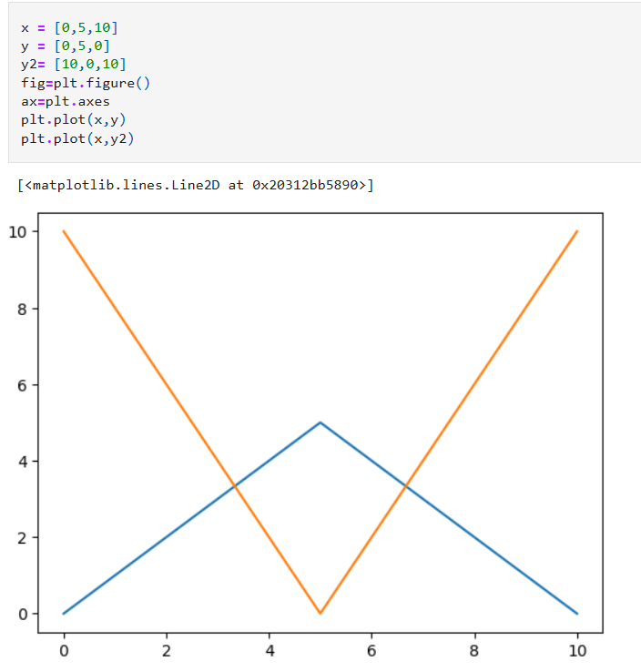
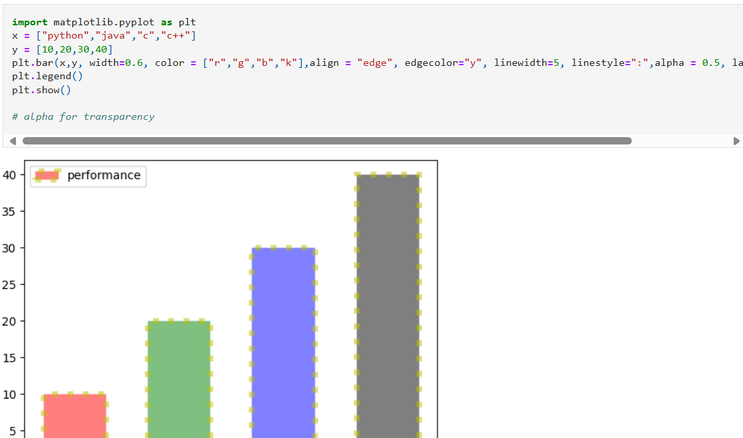
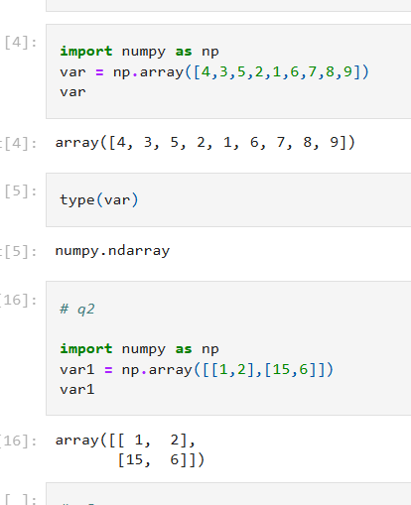

Slide 19
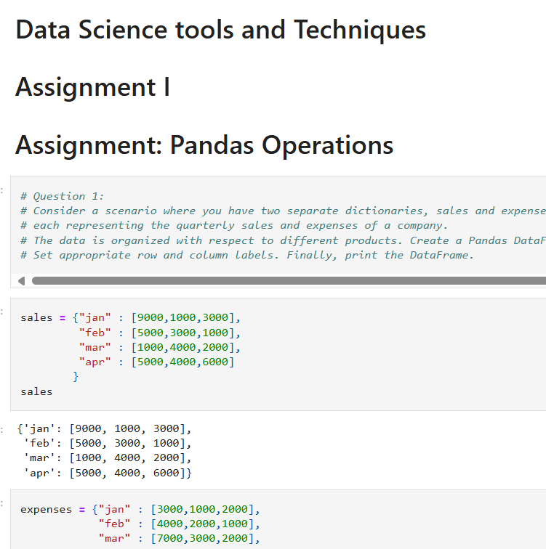
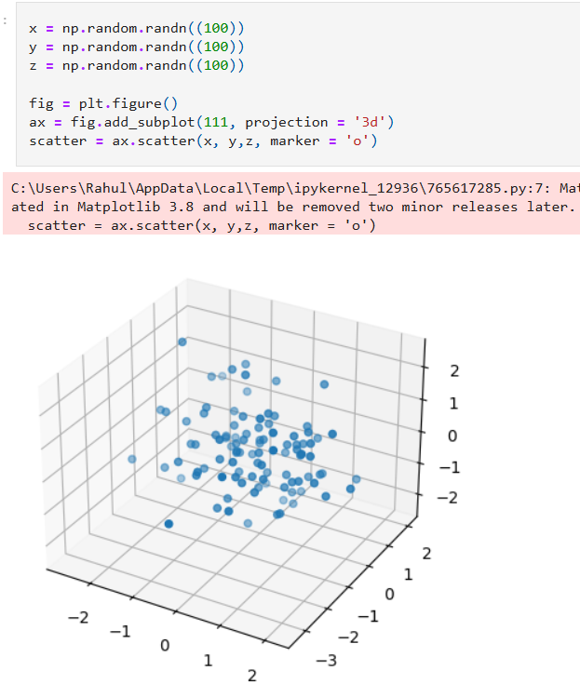

Slide 20
Attached pdf Notes

Slide 21
Thanks You
https://github.com/Amit123456777
https://www.linkedin.com/in/amit-sharma-868b3a23a/
amsharma2607@gmail.com

